Slide 1
Outlier detection (contd…)
Date: 28th March 2020
“You are unique, and if that is not fulfilled, then something has been lost.”—Martha Graham

Slide 2
Applications- Fraud
Fraud detection refers to detection of criminal activities occurring in commercial organizations – Malicious users might be the actual customers of the organization or might be posing as a customer (also known as identity theft).
Types of fraud
– Credit card fraud
– Insurance claim fraud
– Mobile / cell phone fraud
Challenges
– Fast and accurate real-time detection
– Misclassification cost is very high

Slide 3
Applications - Healthcare
Detect anomalous patient records
– Indicate disease outbreaks
– instrumentation errors, etc.
Key Challenges
– Misclassification cost is very high
– Data can be complex: spatio-temporal

Slide 4
Applications – Image Processing
Detecting outliers in an image monitored over time
Detecting anomalous regions within an image
Used in
– mammography image analysis
– video surveillance
– satellite image analysis
Key Challenges
– Detecting collective anomalies
– Data sets are very large

Slide 5
Types of Outliers
Three kinds: global, contextual and collective outliers
Global Outlier
Collective Outlier

Slide 6
Extreme Value Analysis
Such outliers correspond to the statistical tails of probability distributions.
It is important to understand that extreme values are very specialized types of outliers; in other words, all extreme values are outliers, but the reverse may not be true.
The traditional definition of outliers is based on Hawkins’s definition of generative probabilities. Example: {1, 3, 3, 3, 50, 97, 97, 97, 100} where 1 and 100 are Extreme values but 50 is not. Is that an issue?
A similar argument applies to the case of multivariate data where the extreme values lie in the multivariate tail area of the distribution.
An example of an important application of extreme value analysis is that of converting outlier scores to binary labels by identifying those outlier scores that are extreme values.

Slide 7
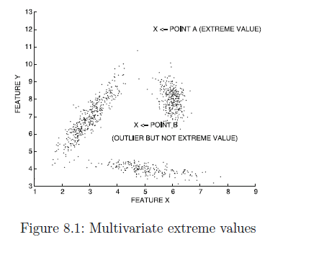

Slide 8
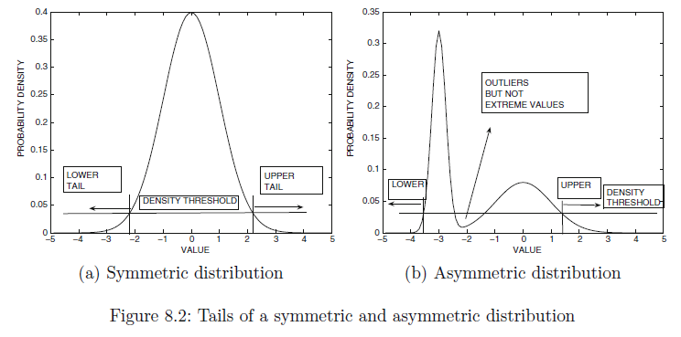
Univariate Extreme Value Analysis

Slide 9
A model distribution is selected for quantifying the tail probability. The most commonly used model is the normal distribution. The density function f_{X}(x) of the normal distribution with mean μ and standard deviation σ is defined as follows:
A standard normal distribution is one in which the mean is 0, and the standard deviation σ is 1. In some application scenarios, the mean μ and standard deviation σ of the distribution may be known through prior domain knowledge. Alternatively, when a large number of data samples is available, the mean and standard deviation may be estimated very accurately. These can be used to compute the Z-value for a random variable.
Large positive values of z_{i} correspond to the upper tail, whereas large negative values correspond to the lower tail. The

Slide 10
Exercise
Suppose a particular random variable has mean 3 and standard deviation 2. Compute the Z-number for the values -1, 0, 3, 7 and 9. Which of these values can be considered the most extreme value?

Slide 11
Multivariate Extreme Value Analysis
As in the previous case, a multivariate Gaussian model is used, and the corresponding parameters are estimated in a data-driven manner.
The implicit modeling assumption of multivariate extreme value analysis is that all data points are located in a probability distribution with a single peak (i.e., single Gaussian cluster), and data points in all directions that are as far away as possible from the center of the cluster should be considered extreme values.
Let μ be the d-dimensional mean vector of a d-dimensional data set, and Σ be its d × d covariance matrix. Thus, the (i, j)^{th} entry of the covariance matrix is equal to the covariance between the dimensions i and j. These represent the estimated parameters of the multivariate Gaussian distribution. Then, the probability distribution f(X) for a d-dimensional data point X can be defined as follows:

Slide 12
Non-Parametric Statistical Analysis
We can use the histogram as a nonparametric statistical model to capture outliers. For example, a transaction in the amount of $7500 can be regarded as an outlier because only 0.2% of transactions have an amount higher than $5000. On the other hand, a transaction amount of $385 can be treated as normal because it falls into the bin (or bucket) holding 60% of the transactions.
As illustrated in the example, the histogram is a frequently used nonparametric statistical model that can be used to detect outliers. The procedure involves the following two steps: Histogram construction and Outlier detection

Slide 13
Anomaly score of 8000 and 385?

Slide 14
Clustering for Outlier Detection
The detection of outliers as a side-product of clustering methods is, however, not an appropriate approach because clustering algorithms are not optimized for outlier detection.
Data points on the boundary regions of a cluster may also be considered weak outliers but are rarely useful in most application-specific scenarios.

Slide 15
Proximity-Based Approaches: Distance-Based vs. Density-Based Outlier Detection
Intuition: Objects that are far away from the others are outliers
Assumption of proximity-based approach: The proximity of an outlier deviates significantly from that of most of the others in the data set
Two types of proximity-based outlier detection methods
Distance-based outlier detection: An object o is an outlier if its neighborhood does not have enough other points
Density-based outlier detection: An object o is an outlier if its density is relatively much lower than that of its neighbors
15

Slide 16
Distance-Based Outlier Detection
For each object o, examine the # of other objects in the r-neighborhood of o, where r is a user-specified distance threshold
An object o is an outlier if most (taking π as a fraction threshold) of the objects in D are far away from o, i.e., not in the r-neighborhood of o
An object o is a DB(r, π) outlier if
Equivalently, one can check the distance between o and its k-th nearest neighbor o_{k}, where . Object o is an outlier if dist(o, o_{k}) > r
Efficient computation: Nested loop algorithm
For any object o_{i}, calculate its distance from other objects, and count the # of other objects in the r-neighborhood.
If π∙n other objects are within r distance, terminate the inner loop
Otherwise, o_{i} is a DB(r, π) outlier
Efficiency: Actually CPU time is not O(n²) but linear to the data set size since for most non-outlier objects, the inner loop terminates early
16

Slide 18
Distance based Outlier Detection
The distance-based outlier score of an object O is its distance to its kth nearest neighbor.
Distance-based methods typically use a finer granularity of analysis than clustering methods and can therefore distinguish between ambient noise and truly isolated anomalies.
This is because ambient noise will typically have a lower k-nearest neighbor distance than a truly isolated anomaly.
The price of this better granularity is higher computational complexity. Therefore, a variety of methods are used to speed up the computation: Index structures and Pruning tricks

Slide 19
Pruning methods
Pruning methods are used only for the case where the top-r ranked outliers need to be returned, and the outlier scores of the remaining data points are irrelevant.
Sampling Methods
Early Termination Trick with Nested Loops

Slide 20
Sampling methods
The first step is to pick a sample S of size s n from the data D, and compute all pairwise distances between the data points in sample S and those in database D.
Thus, for each of the sampled points in S, the k-nearest neighbor distance is already known exactly.
The top r^{th} ranked outlier in sample S is determined, where r is the number of outliers to be returned.
The score of the r^{th} rank outlier provides a lower bound L on the r^{th} ranked outlier score over the entire data set D.
For the data points in D−S, only an upper bound V ^{k}(X) on the k-nearest neighbor distance is known.
This upper bound is equal to the k-nearest neighbor distance of each point in D − S to the sample S ⊂ D.
Typically, this will result in the removal of a large number of outlier candidates from D−S immediately, as long as the underlying data set is clustered well.

Slide 21
Early Termination Trick with Nested Loops
The approach discussed in the previous section can be improved even further by speeding up the second phase of computing the k-nearest neighbor distances of each data point in R.

Slide 22
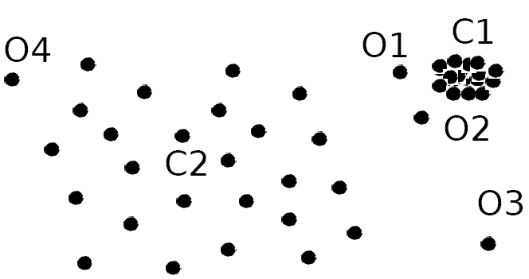
Density-Based Outlier Detection
Local outliers: Outliers comparing to their local neighborhoods, instead of the global data distribution
In Fig., o₁ and o2 are local outliers to C₁, o₃ is a global outlier, but o₄ is not an outlier. However, proximity-based clustering cannot find o₁ and o₂ are outlier (e.g., comparing with O₄).
Intuition (density-based outlier detection): The density around an outlier object is significantly different from the density around its neighbors
Method: Use the relative density of an object against its neighbors as the indicator of the degree of the object being outliers
k-distance of an object o, dist_{k}(o): distance between o and its k-th NN
k-distance neighborhood of o, N_{k}(o) = {o’| o’ in D, dist(o, o’) ≤ dist_{k}(o)}
N_{k}(o) could be bigger than k since multiple objects may have identical distance to o
22

